Slide 1

Well intervention Data handling tool manual V.2
Digitalization of Well Intervention & Well Services Area

Slide 2
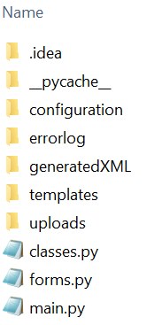
layout
Well intervention Data handling tool manual
Requirements are stored: service type, data type, log names
Error log after check is stored here
Generated XML is stored here

Slide 3
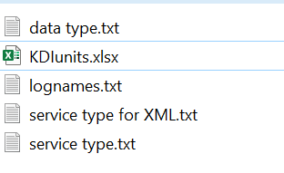
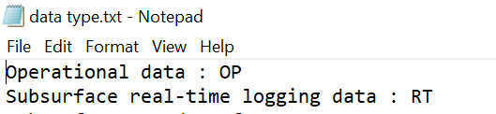
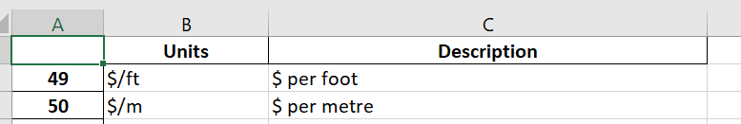
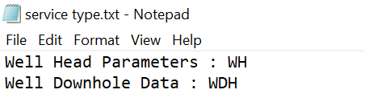
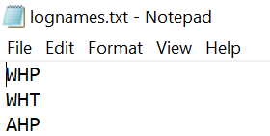
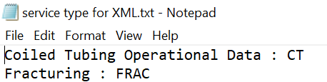
configuration
Well intervention Data handling tool manual
Files can be updated, but the file name should stay the same together with a formatting inside
For mnemonics
As part of serviceCategory XML tag

Slide 4
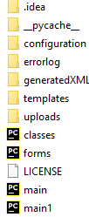
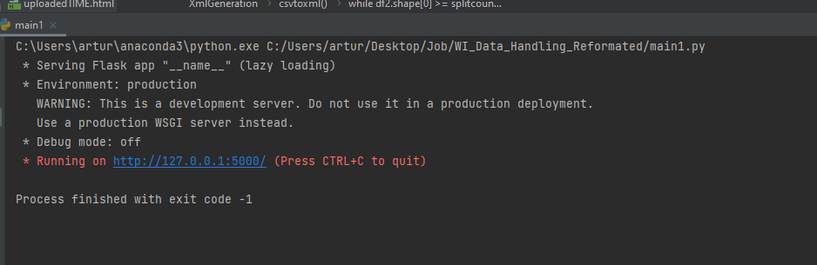

Launch application (pycharm example)
Well intervention Data handling tool manual
Click on link
Run main1.py
Open main1.py

Slide 5
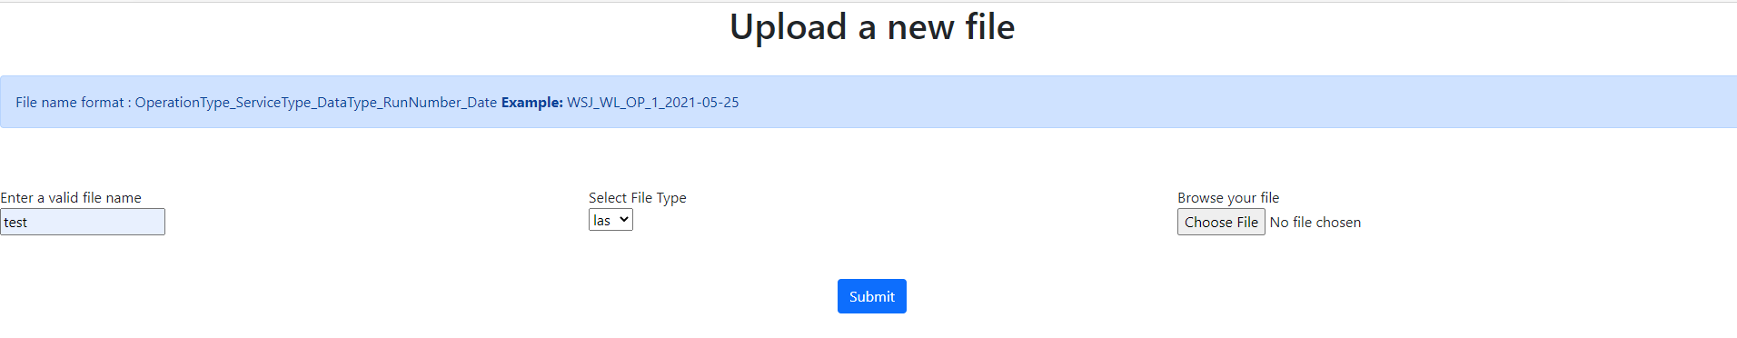
Upload page
Well intervention Data handling tool manual
Specify file
Upload file
Click “Submit”

Slide 6
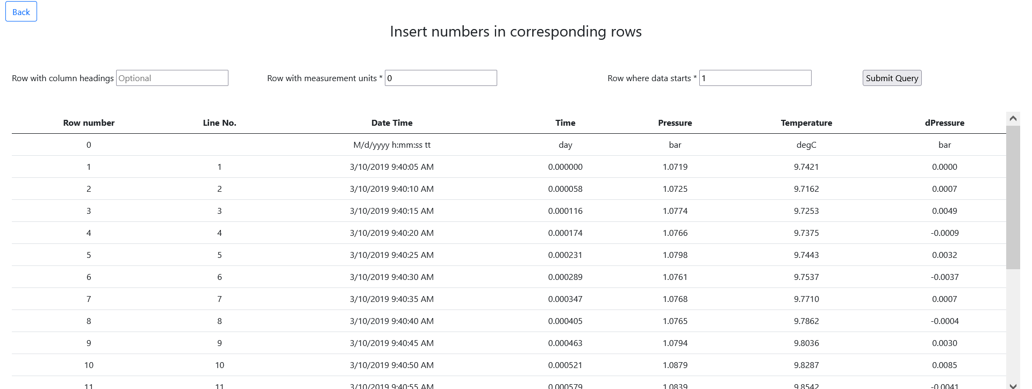
Csv header
Well intervention Data handling tool manual
In case CSV file has been uploaded, there is an intermediate step to determine a header position because it is not fixed
Specify a row with columns (if it is incorrect, optional) and rows with measurement units and data start (mandatory)

Slide 7
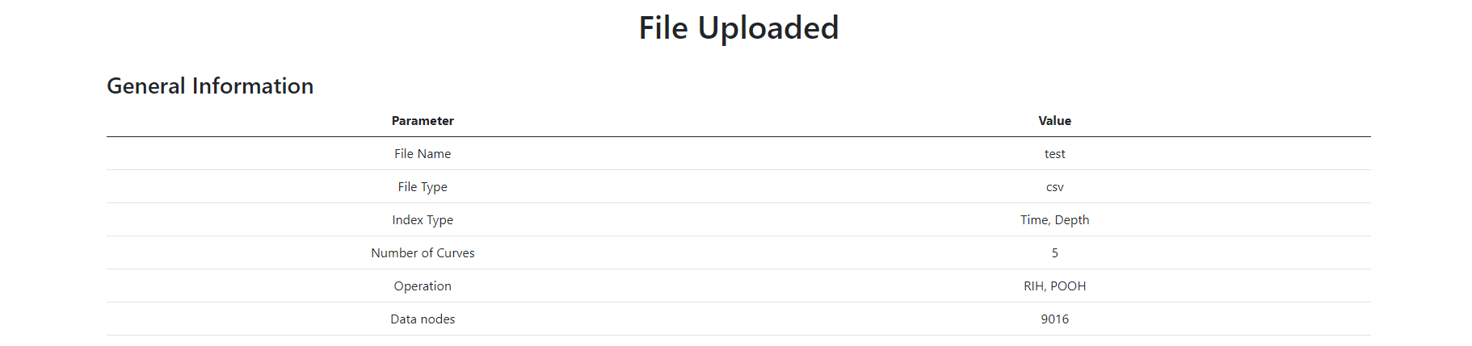
FILE UPLOADED
Well intervention Data handling tool manual
On this page, the information from the previous step is shown + operation, index type, number of curves and data nodes
Files with data nodes > 10000 will be automatically split

Slide 8
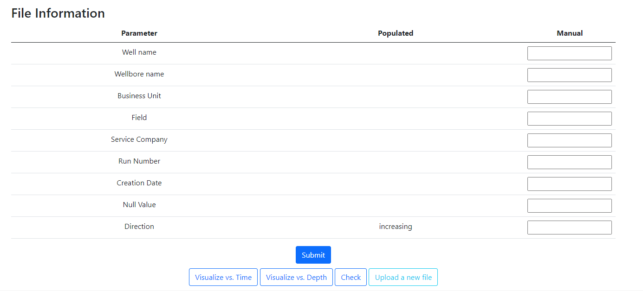
FILE UPLOADED
Well intervention Data handling tool manual
If Manual data is entered it will overwrite populated data, which is read from the file
Generate an XML file (for input LAS, CSV, DLIS files)
Visualization
Check according to the WD (and KDI) requirements

Slide 9
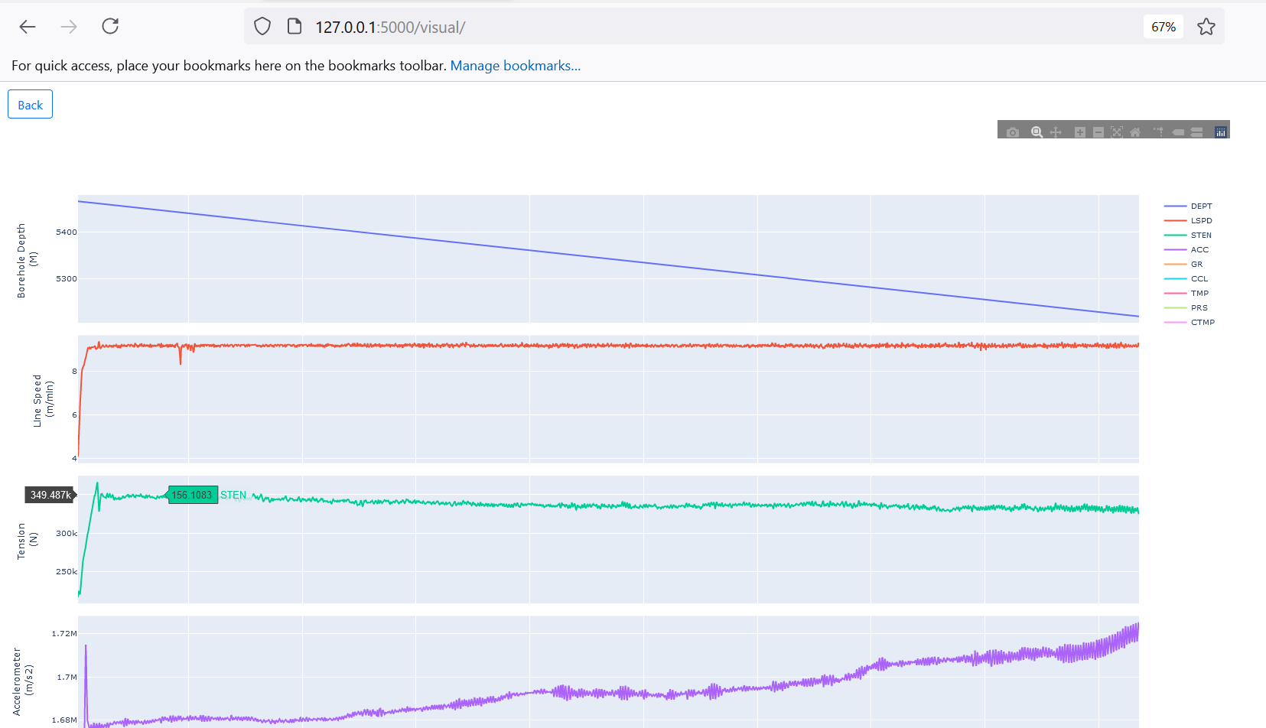
Visualization vs. time
Well intervention Data handling tool manual

Slide 10
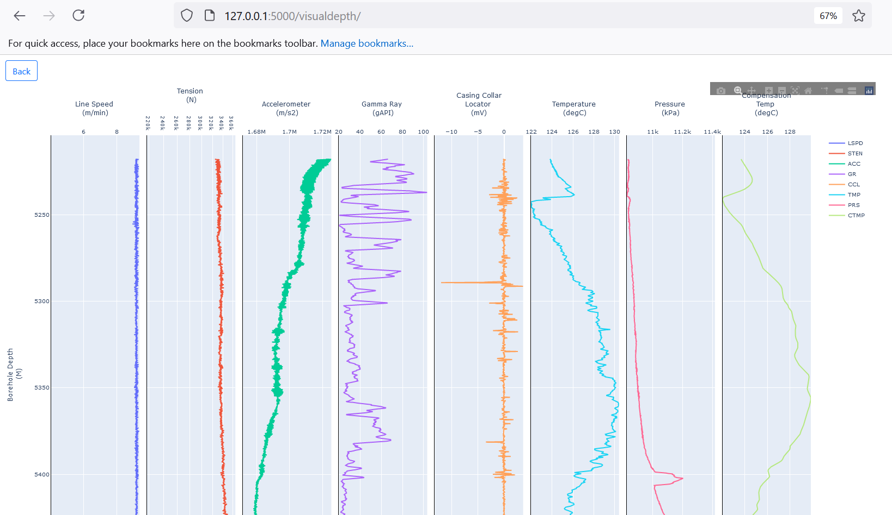
Visualization vs. depth
Well intervention Data handling tool manual

Slide 11
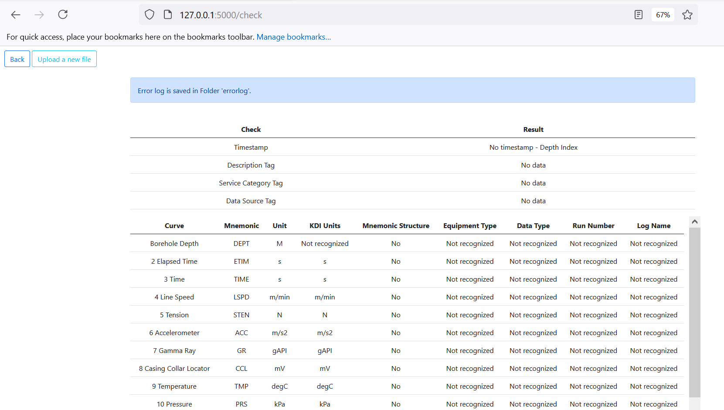
Check according to the wd/kdi requirements
Well intervention Data handling tool manual
Check timestamp and WD required tags
Check if units are recognized in KDI
Check if mnemonic names are recognized according to the WD required structure
Notes:
Add about XML

Slide 12
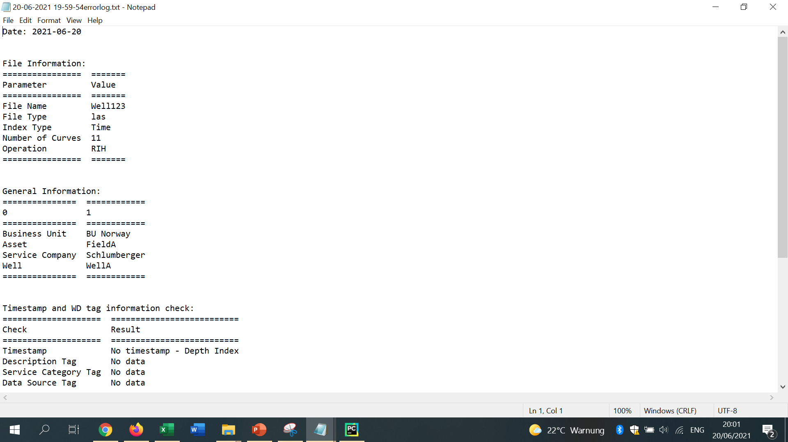
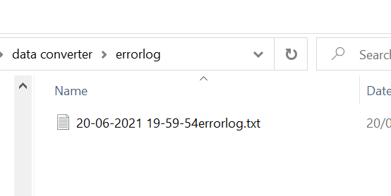
Error log
Well intervention Data handling tool manual

Slide 13
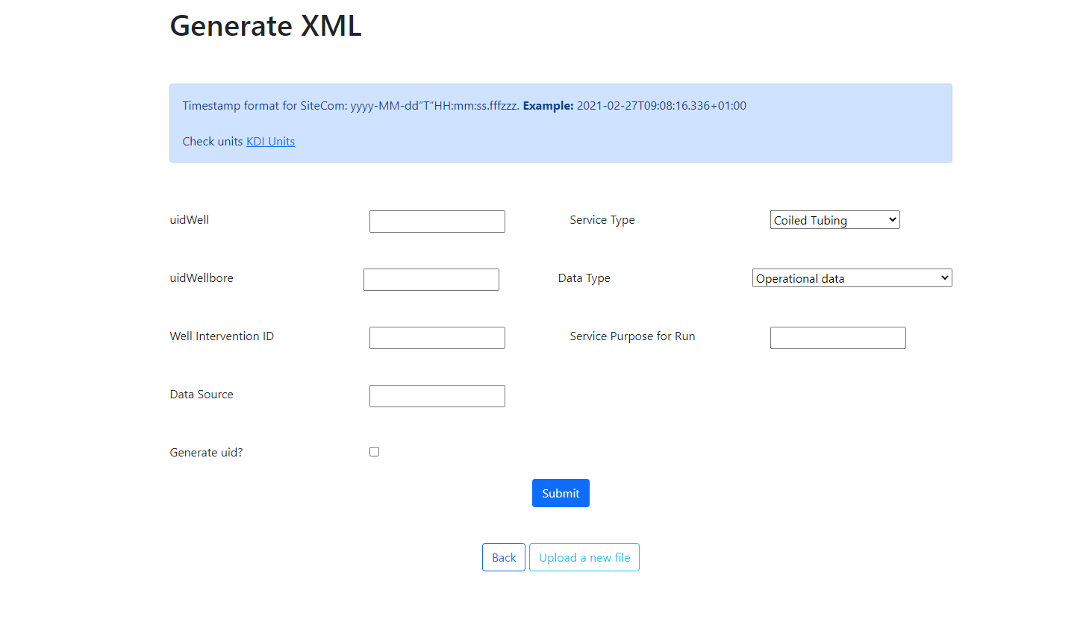
Generate xml out of las, csv
Well intervention Data handling tool manual
On this step, it is possible to look up the units
Provided by KDI
Specify information
Click ‘Submit’
Generates a unique identificator

Slide 14
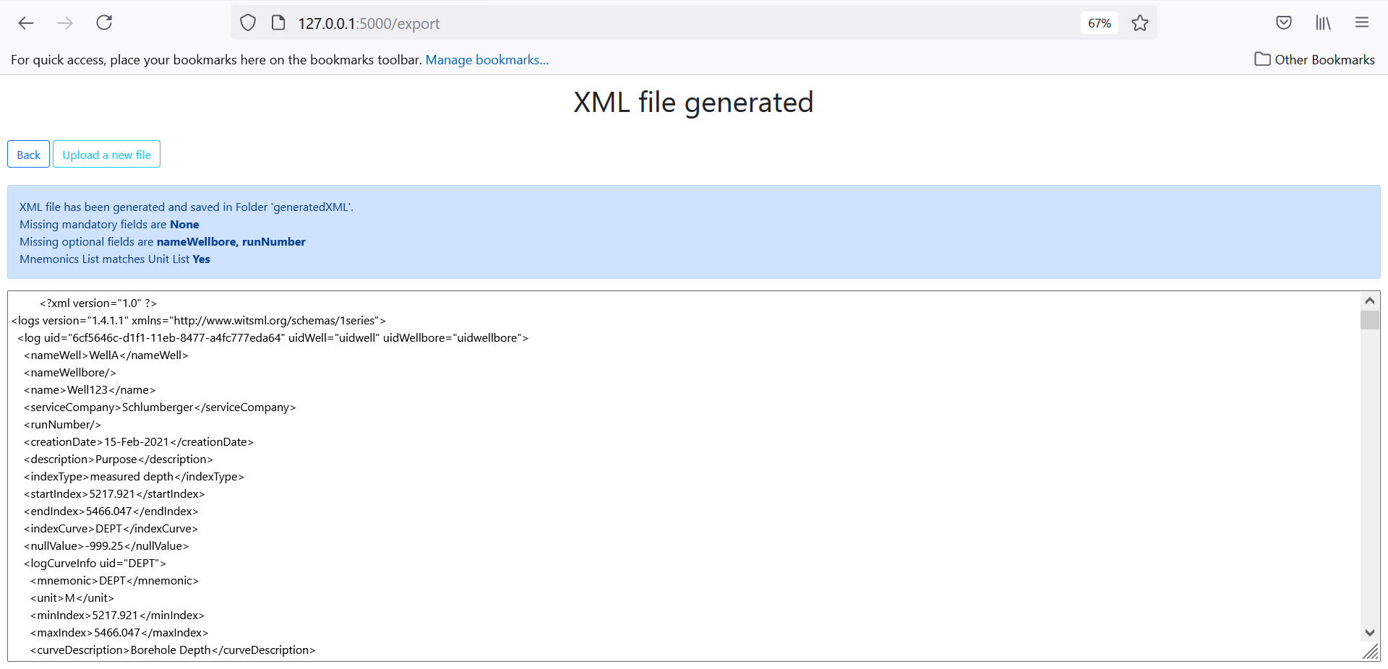
Xml file generated
Well intervention Data handling tool manual
When an XML file is generated, missing fields are shown.
Generated XML content is displayed on the screen

Slide 15
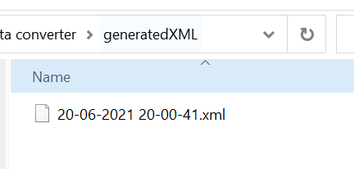
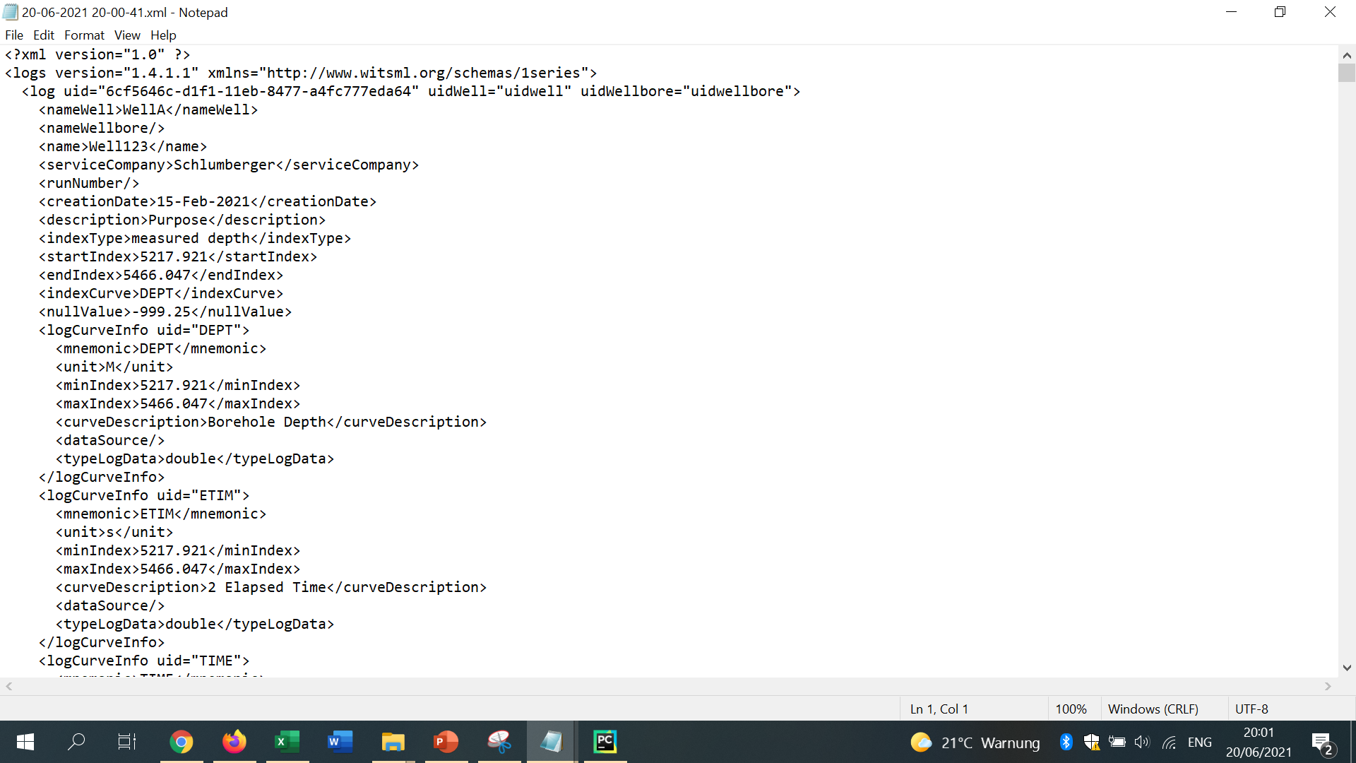
Xml file generated - 2
Well intervention Data handling tool manual

